Slide 1
Computer Aided Engineering Design
Anupam Saxena
Associate Professor
Indian Institute of Technology KANPUR 208016

Slide 2
Euler operators
Given a polyhedron model, one may want to edit it by adding or deleting edges, vertices, faces and genus to create a new polyhedron
One can use Euler operators
Geometric/PARAMETRIC Modeling
Solid Modeling
Perception of Solids
Modeling of Curves
Modeling of Surfaces (Patches)
Topology and Solids
Solid Modeling 1-2
Transformations and Projections 1-2
Representation, Differential Geometry
Ferguson Segments
Bezier Segments 1-2
B-spline curves 1-5
NURBS
Differential Geometry
Tensor Product
Boundary Interpolating
Composite
NURBS

Slide 3
Make and Kill groups
Euler operators are written as Mxyz or Kxyz
M for Make and K for Kill groups
x, y and z represent a vertex, edge, face, loop, shell or genus
e.g., MEV ≡ adding an edge and a vertex
KEV ≡ killing (deleting) an edge and a vertex
Geometric/PARAMETRIC Modeling
Solid Modeling
Perception of Solids
Modeling of Curves
Modeling of Surfaces (Patches)
Topology and Solids
Solid Modeling 1-2
Transformations and Projections 1-2
Representation, Differential Geometry
Ferguson Segments
Bezier Segments 1-2
B-spline curves 1-5
NURBS
Differential Geometry
Tensor Product
Boundary Interpolating
Composite
NURBS

Slide 4
Operators and relation
Operators are designed such that
V – E + F – (L – F) – 2(S – G) = 0
is always satisfied
using a finite sequence of operators, any polyhedron can be constructed from any other, or from scratch
Geometric/PARAMETRIC Modeling
Solid Modeling
Perception of Solids
Modeling of Curves
Modeling of Surfaces (Patches)
Topology and Solids
Solid Modeling 1-2
Transformations and Projections 1-2
Representation, Differential Geometry
Ferguson Segments
Bezier Segments 1-2
B-spline curves 1-5
NURBS
Differential Geometry
Tensor Product
Boundary Interpolating
Composite
NURBS

Slide 5
Make Group operators
Operator | Implication | V | E | F | L | S | G | Change in Euler-Poincaré formula
MEV | Make an edge and a vertex | +1 | +1 |  |  |  |  | 0
MFE | Make a face and an edge |  | +1 | +1 | +1 |  |  | 0
MSFV | Make a shell, a face and a vertex | +1 |  | +1 | +1 | +1 |  | 0
MSG | Make a shell and a genus |  |  |  |  | +1 | +1 | 0
MEKL | Make an edge, Kill and loop |  | +1 |  | −1 |  |  | 0
Geometric/PARAMETRIC Modeling
Solid Modeling
Perception of Solids
Modeling of Curves
Modeling of Surfaces (Patches)
Topology and Solids
Solid Modeling 1-2
Transformations and Projections 1-2
Representation, Differential Geometry
Ferguson Segments
Bezier Segments 1-2
B-spline curves 1-5
NURBS
Differential Geometry
Tensor Product
Boundary Interpolating
Composite
NURBS

Slide 6
Kill group Operators
Operator | Implication | V | E | F | L | S | G | Change in Euler-Poincaré formula
KEV | Kill an edge and a vertex | −1 | −1 |  |  |  |  | 0
KFE | Kill a face and an edge |  | −1 | −1 | −1 |  |  | 0
KSFV | Kill a shell, a face and a vertex | −1 |  | −1 | −1 | −1 |  | 0
KSG | Kill a shell and a genus |  |  |  |  | −1 | −1 | 0
KEML | Kill an edge, Make a loop |  | −1 |  | +1 |  |  | 0
Geometric/PARAMETRIC Modeling
Solid Modeling
Perception of Solids
Modeling of Curves
Modeling of Surfaces (Patches)
Topology and Solids
Solid Modeling 1-2
Transformations and Projections 1-2
Representation, Differential Geometry
Ferguson Segments
Bezier Segments 1-2
B-spline curves 1-5
NURBS
Differential Geometry
Tensor Product
Boundary Interpolating
Composite
NURBS

Slide 7
Example: Cube construction using Euler Operators
Operator | V | E | F | L | S | G
MSFV | +1 |  | +1 | +1 | +1
MEV | +1 | +1
MEV | +1 | +1
MEV | +1 | +1
MEV | +1 | +1
MEV | +1 | +1
MFE |  | +1 | +1 | +1
MEV | +1 | +1
MFE |  | +1 | +1 | +1
MFE |  | +1 | +1 | +1
MFE |  | +1 | +1 | +1
MFE |  | +1 | +1 | +1
MEV | +1 | +1
Geometric/PARAMETRIC Modeling
Solid Modeling
Perception of Solids
Modeling of Curves
Modeling of Surfaces (Patches)
Topology and Solids
Solid Modeling 1-2
Transformations and Projections 1-2
Representation, Differential Geometry
Ferguson Segments
Bezier Segments 1-2
B-spline curves 1-5
NURBS
Differential Geometry
Tensor Product
Boundary Interpolating
Composite
NURBS

Slide 8
Constructive Solid Geometry
CSG for short
solids can be generated by combining primitives using Boolean operations.
Primitives: block, cone, cylinder, sphere, triangular prism, torus and many others.
Primitives can also be user-defined solids
Geometric/PARAMETRIC Modeling
Solid Modeling
Perception of Solids
Modeling of Curves
Modeling of Surfaces (Patches)
Topology and Solids
Solid Modeling 1-2
Transformations and Projections 1-2
Representation, Differential Geometry
Ferguson Segments
Bezier Segments 1-2
B-spline curves 1-5
NURBS
Differential Geometry
Tensor Product
Boundary Interpolating
Composite
NURBS

Slide 9
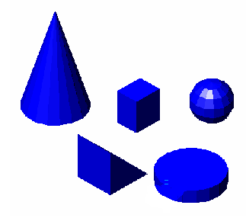
Some primitives
Geometric/PARAMETRIC Modeling
Solid Modeling
Perception of Solids
Modeling of Curves
Modeling of Surfaces (Patches)
Topology and Solids
Solid Modeling 1-2
Transformations and Projections 1-2
Representation, Differential Geometry
Ferguson Segments
Bezier Segments 1-2
B-spline curves 1-5
NURBS
Differential Geometry
Tensor Product
Boundary Interpolating
Composite
NURBS

Slide 10
CSG operations
Primitives are first instantiated, transformed and then combined to form more complex solids.
Instantiation involves making available a copy of the primitive (if existing) from the database.
Transformation is required to scale or position a primitive with respect to others (or their Boolean result)
The primitive may then be joined with, cut from or intersected with an existing solid to get the desired features.
Geometric/PARAMETRIC Modeling
Solid Modeling
Perception of Solids
Modeling of Curves
Modeling of Surfaces (Patches)
Topology and Solids
Solid Modeling 1-2
Transformations and Projections 1-2
Representation, Differential Geometry
Ferguson Segments
Bezier Segments 1-2
B-spline curves 1-5
NURBS
Differential Geometry
Tensor Product
Boundary Interpolating
Composite
NURBS

Slide 11
Example: Bracket construction
Block 1
Geometric/PARAMETRIC Modeling
Solid Modeling
Perception of Solids
Modeling of Curves
Modeling of Surfaces (Patches)
Topology and Solids
Solid Modeling 1-2
Transformations and Projections 1-2
Representation, Differential Geometry
Ferguson Segments
Bezier Segments 1-2
B-spline curves 1-5
NURBS
Differential Geometry
Tensor Product
Boundary Interpolating
Composite
NURBS
Block 2
Boolean
JOIN
scaling
transformation
instantiation
scaling
transformation
instantiation

Slide 12
CSG: Computer Modeling
The block primitives above may be treated as objects named Block 1 and Block 2
They may be identified by the three dimensions (length, width and height)
The instantiations of initially standard sizes can be at the global origin.
One may scale the three dimensions of a block by factors, say x, y and z using the scale command. scale(Block 1, x₁, y₁, z₁).
One may translate the block so that the reference point would be shifted by, say (a, b, c) with respect to the origin. translate(scale(Block 1, x₁, y₁, z₁), a₁, b₁, c₁).
Similar operations for Block 2 would be translate(scale(Block 2, x₂, y₂, z₂), a₂, b₂, c₂).
The blocks would be united using the Boolean union or JOIN command
JOIN( translate( scale(Block 1, x₁, y₁, z₁), a₁, b₁, c₁) , translate(scale(Block 2, x₂, y₂, z₂), a₂, b₂, c₂))
Geometric/PARAMETRIC Modeling
Solid Modeling
Perception of Solids
Modeling of Curves
Modeling of Surfaces (Patches)
Topology and Solids
Solid Modeling 1-2
Transformations and Projections 1-2
Representation, Differential Geometry
Ferguson Segments
Bezier Segments 1-2
B-spline curves 1-5
NURBS
Differential Geometry
Tensor Product
Boundary Interpolating
Composite
NURBS

Slide 13
CSG/History tree
CSG operations can be represented as a tree
Geometric/PARAMETRIC Modeling
Solid Modeling
Perception of Solids
Modeling of Curves
Modeling of Surfaces (Patches)
Topology and Solids
Solid Modeling 1-2
Transformations and Projections 1-2
Representation, Differential Geometry
Ferguson Segments
Bezier Segments 1-2
B-spline curves 1-5
NURBS
Differential Geometry
Tensor Product
Boundary Interpolating
Composite
NURBS
+
−
transform (Block 2)
transform (Cylinder 2)
−
Block 2
Cylinder 2
transform (Block 1)
transform (Cylinder 1)
Block 1
Cylinder 1

Slide 14
Boolean Operations
Two sets (solids) A and B,
Their union (A∪B) consists of all points belonging to A and B.
Their intersection (A∩B) consists of points common to both A and B
Their difference A – B consists of points in A but not in B.
Similarly, B – A would consist of points only in B and not in A.
Geometric/PARAMETRIC Modeling
Solid Modeling
Perception of Solids
Modeling of Curves
Modeling of Surfaces (Patches)
Topology and Solids
Solid Modeling 1-2
Transformations and Projections 1-2
Representation, Differential Geometry
Ferguson Segments
Bezier Segments 1-2
B-spline curves 1-5
NURBS
Differential Geometry
Tensor Product
Boundary Interpolating
Composite
NURBS

Slide 15
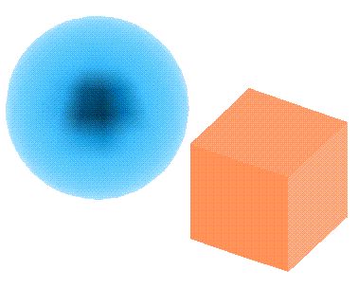
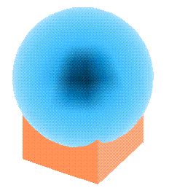
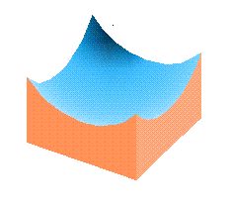
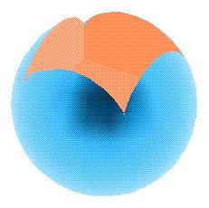
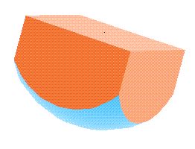
Example: Boolean Operations
Geometric/PARAMETRIC Modeling
Solid Modeling
Perception of Solids
Modeling of Curves
Modeling of Surfaces (Patches)
Topology and Solids
Solid Modeling 1-2
Transformations and Projections 1-2
Representation, Differential Geometry
Ferguson Segments
Bezier Segments 1-2
B-spline curves 1-5
NURBS
Differential Geometry
Tensor Product
Boundary Interpolating
Composite
NURBS
(b) union
(c) intersection
(d) cube – sphere
(e) sphere – cube

